Slide 1
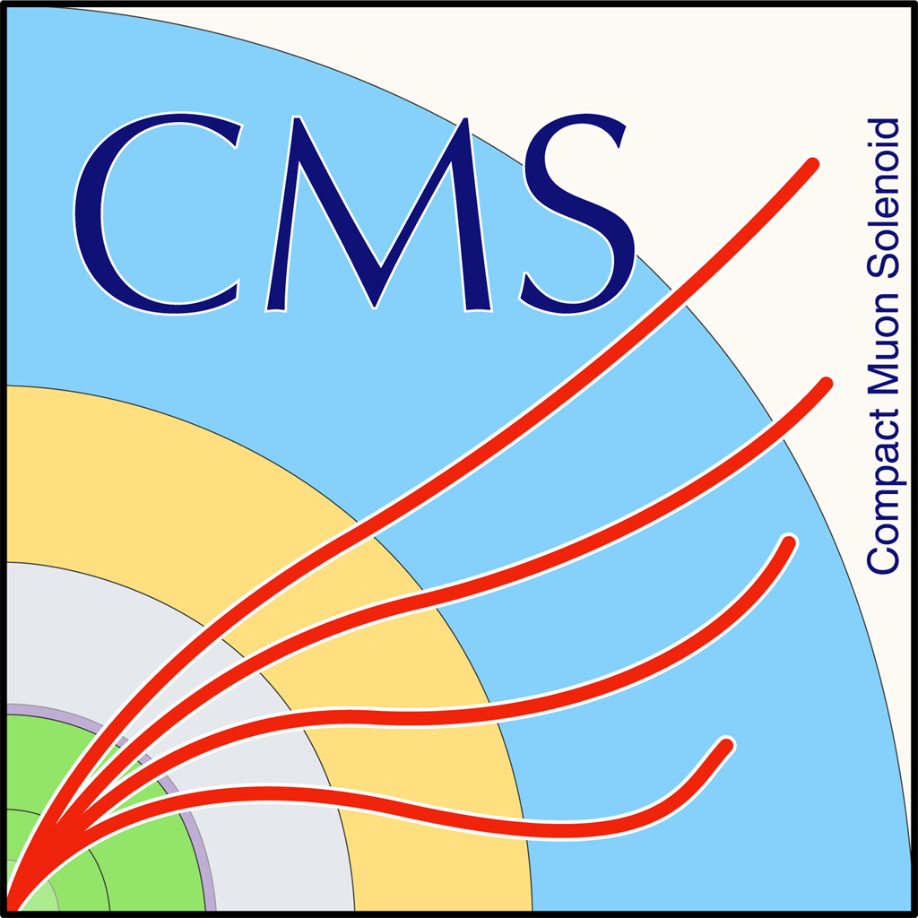

HEP Weekly Report
George Bakas

Slide 2
Weekly Report
Analysis
Background shape extraction
Get familiar with RooFit
Fit in SR_{A} region
Signal Region (SR): Baseline selection + topTagger + b-tagging (2 b-tag) + Mass Cut [120,220]GeV
Control Region (CR): Baseline selection + topTagger + revert b-tagging + Mass Cut [120,220]GeV
Signal Region A (SR_{A}): Extended SR → SR – Mass Cut
In SR_{A} we fit signal from MC, Subdominant Bkg from MC and Data
MergeFilesMC.py : piece of code to hadd all root files from production
Changes in the eostools.py script → script is throwing errors
Avoid functions from eostools.py
Script is now using NO eostools.py functions
Not working on lxplus7 (looking into this)→ Lisa Found out why, probably a library is not loaded in the new root version leading to inconcistencies

Slide 3
Weekly Report
Template of the tt signal from MC
The shape consists of:
a smooth polynomial
two Gaussians (one describes the W resonance from unmerged top decays and the other describes the fully merged top resonance).

Slide 4
Weekly Report
The shape of the subdominant bkgs is taken from simulation
The subdominant backgrounds contains a smooth polynomial and two Gaussians
The QCD shape is taken from data
The QCD shape is composed of a smooth polynomial and a Gaussian + Gaussian for W resonance.

Slide 5
Weekly Report

